Slide 1
Reliability-aware Dynamic Service Chain Scheduling in 5G Networks based on Reinforcement Learning

Slide 2
ABSTRACT
Service Function Chain (SFC) forwards the traffic flow along a chain of Virtual Network Functions (VNFs) to provide network services flexibility.
One of the most important problems in SFC is to deploy the VNFs and schedule arriving requests among computing nodes to achieve low latency and high reliability.
This paper focuses on the dynamic 5G network environment where the SFC requests arrive randomly and the computing nodes can redeploy all types of VNF with a time cost.
The objective is to maximize the number of requests satisfying the latency and reliability constraints.
To solve the problem an efficient algorithm is proposed to decide the redundancy of the VNFs while minimizing delay. Reinforcement Learning (RL) is presented to learn SFC scheduling policy to increase the success rate of SFC requests.

Slide 3
Introduction
Traditionally, a network function is implemented by dedicated hardware devices (middle boxes), which increases both the capital and operational cost of network service providers, meanwhile causing the problems of network coupling.
To address this challenge, NFV transfers the implementation of network function from dedicated hardware to software-based component named Virtual Network Function (VNF) [1]. VNFs are abstract network functions running on general commodity (e.g., x86 based systems) servers without specific hardware devices.
In NFV framework, an ordered combination of several VNF instances comprises a Service Function Chain (SFC)

Slide 4
In order to enhance the reliability of a network service, an SFC execution needs to have additional redundant VNF instances. But the redundant instances occupy more computing resource and hence cause a higher waiting time for other network services.
Thus it is essential that the SFC scheduler in 5G environment should be more intelligent to balance between latency and reliability.
A computing node should switch its deployed VNF type to satisfy new types of VNF in the incoming SFC requests. However, the redeployment of various VNFs on a computing node is not cost-free; the node must shut down the previous VNF and set up the new VNF, which introduces additional redeployment time.

Slide 5
Approach
Here an efficient approach is proposed by separating the redundancy determining from SFC scheduling.
For the former, a heuristic algorithm is used to decide the redundancy of the VNFs while minimizing delay.
For SFC scheduling a Reinforcement Learning (RL) method is used based on policy gradient to place these VNFs on computing nodes with the objective of maximizing the success rate of SFC requests.

Slide 6
SFC Model
The orchestrator is in charge of network service chaining and VNF placement.
It accepts the network service request, transforms the request into an SFC, and maps the VNFs into the virtual machines provided by the virtualization layer.
Physical Machines (PMs) are virtualized through a virtualized layer to provide abstract resources for VNFs

Slide 7
Network Model
We assume that the physical network is a fully connected network.
We concentrate on SFC scheduling problem at the application layer.
The end-to-end delay can be defined as the sum of processing time and waiting time. The processing time of a VNF is calculated as: pf = w_{f} /V_{k} , where w_{f} is the computation load of VNF f and V_{k} is the computation speed of computing node k.

Slide 8
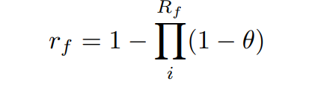
The reliability of a VNF is the probability that at least one of the redundant subcomponents is available. We define θ as the reliability of a computing node, which specifies the probability of successful completion of a VNF on the node. Then, the reliability of a VNF is defined as:
where r_{f} is the reliability of VNF f and R_{f} is the redundancy of f.

Slide 9
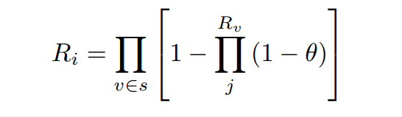
With respect to an end-to-end service, the end-to-end reliability is calculated as the product of the reliability of the VNFs comprising the SFC. Thus, the reliability of an SFC is:
where v specifies one of the VNF in the SCF s and and Rv is the redundancy of v.

Slide 10
When an SFC request arrives, our problem is to decide the redundancy of each VNF and place these VNF instances on the nodes.
A node can switch its type of VNF (i.e. redeployment) with a redeployment delay Δ. Further, we assume that all the nodes have the same reliability θ.
The redundant VNFs can run on different nodes or rerun on the same node.

Slide 11
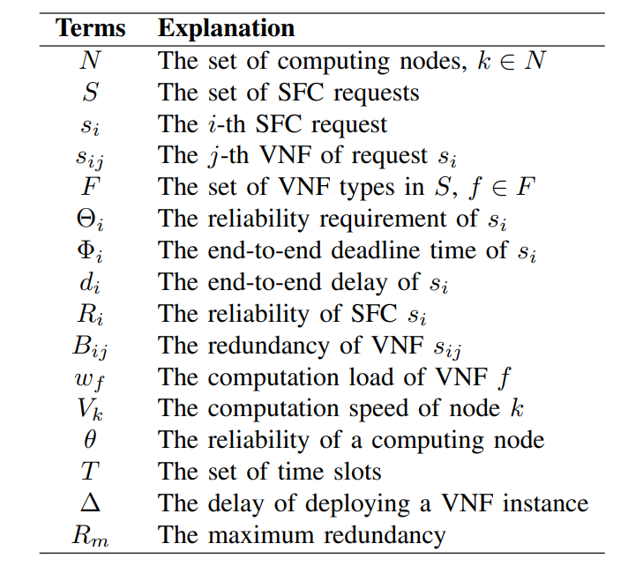
Table

Slide 12

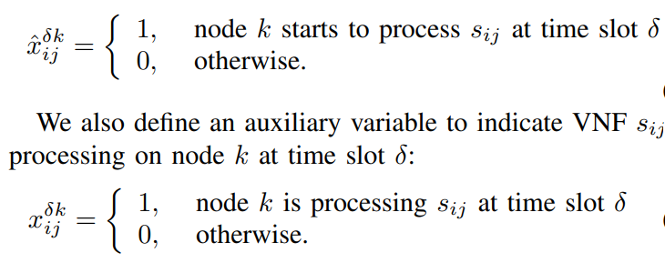
Decision Variables
We use to indicate that the computing node k starts to process VNF s_{ij} at time slot δ.

Slide 13
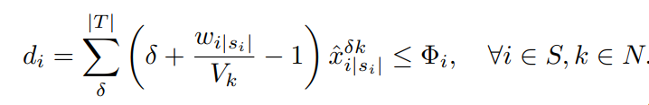
End-to-End Delay Constraints.
The following constraints guarantee the end-to-end delay of a chain should meet its deadline requirement:-

Slide 14
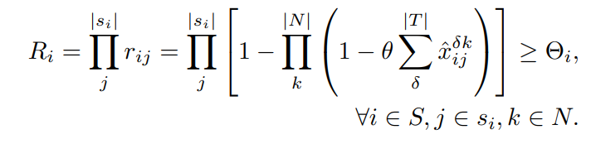
Reliability Constraints
The following constraint shows that the number of VNF redundant instances should ensure the SFC request reliability requirement.

Slide 15
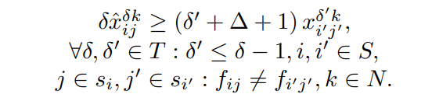
VNF Deployment Delay Constraint
There is a redeployment delay Δ when a computing node shut down its running VNF instance and deploy a different type of VNF instance.

Slide 16
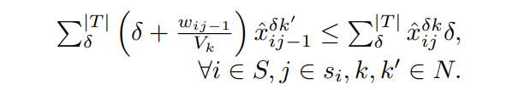
Sequence Order Constraint.
The following constraint ensures the order of the VNF chain in request s_{i}. The VNF s_{ij} should complete when the next VNF s_{ij}+1 starts to process.

Slide 17
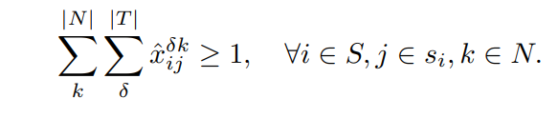
VNF Processing Constraint.
Each VNF s_{ij} should be hosted in some computing node. The following constraint ensures that a VNF is instantiated more than once.

Slide 18
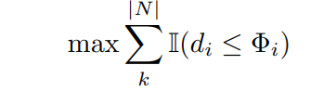
A request s_{i} is successful if its delay d_{i} does not exceed its deadline Φ_{i}. The objective is defined as follows, where I is indicator function.

Slide 19
Solutions to reliability aware SFC scheduling
The reliability aware SFC scheduling procedure is decomposed into two subproblems:-
The first sub-problem is determining the optimal number of VNF redundancies to guarantee the reliability requirement. So a heuristic approach is proposed to determine the optimal number of redundancies while avoiding high latency.
The second sub-problem is mapping these VNFs into appropriate computing nodes with the goal of maximizing the number of successful SFC requests. An intelligent RL-based algorithm is developed to handle the SFC mapping problem

Slide 20
Reliability-aware Dynamic SFC Scheduling Approach(RDSSA)
It includes three critical steps:-
Redundancy Determining
Rule-based Approach for Node Selection
Reinforcement Learning for Dynamic SFC Scheduling

Slide 21
Redundancy Determining is used to calculate the optimal redundancy of VNFs according to the required SFC reliability. It specifies which VNF in the SFC should be replicated and how many redundant VNFs should be deployed.
Rule-based Approach for Node Selection provides a strategy that selects an appropriate computing node for the VNF at head of the queue.
Reinforcement Learning for Dynamic SFC Scheduling learns a deferring policy according to the change of network environment. If it decides to defer a VNF, the VNF is returned to the queue. Otherwise, the scheduler adopts the rule-based approach to allocate the node for the VNF.

Slide 22
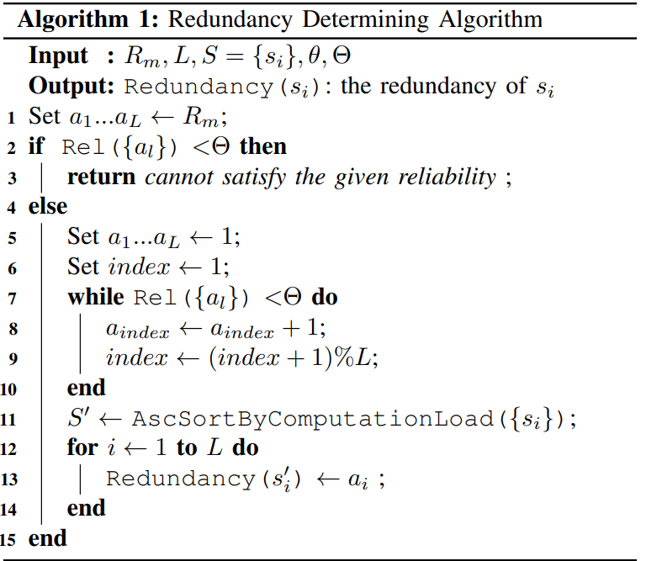
Redundancy Determining Algorithm

Slide 23
The reliability of the a computing node θ is set to 0.96.
The redundancy list A is initialized to 1, then increments from left to right in a loop until it meets the required reliability Θ.
After that, we sort the VNFs by computation load in ascending order. In this case, the number of redundant VNFs corresponds to the number in the redundancy list.
Algorithm 1 ensures that the difference between two number in the redundancy list A is less than 1, which can proved to be the maximum reliability when a fixed amount of redundancies is given.
We prefer the VNF with a lower-load to have more redundancies because it costs a shorter processing time compared to the VNF with a high load.

Slide 24
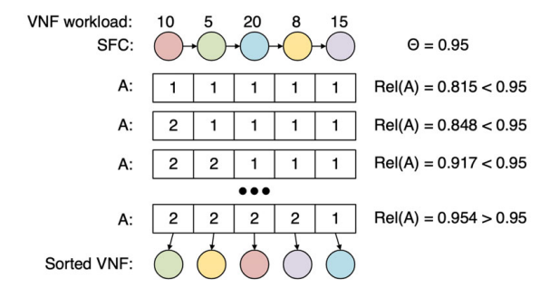
An example for redundancy determining.

Slide 25
Rule-based Approach for Node Selection
In this case, we consider the rule-based methods for FJSP, such as Earliest Finish First (EFF) and Earliest Start First (ESF). EFF selects the node that is able to finish the VNF earlier. ESF selects the node that starts with the VNF earlier.

Slide 26
Reinforcement Learning for Dynamic SFC Scheduling
The RL agent input the current state of the SFCs and outputs a scheduling action. A scheduling agent observes SFC requests and computing nodes state to decide a scheduling action under the NFV-based 5G network environment. The agent obtains a reward after performing an action, and updates the network parameters.

Slide 27
Scheduling Events
Our scheduling model is task triggered. The unscheduled VNFs are waiting in a queue. The RL agent should make a scheduling decision when the VNF waiting queue is not empty. The behaviors of the queue are as follow:-
The priority of the queue is based on the remaining time from the deadline.
The first VNF (with its all redundancies) of the newly arrived SFC will be added to the queue.
When a VNF (with its all redundancies) is completed, its successor will be added to the queue unless the former is the last task.

Slide 28
If one of the VNF redundancies is completed, the others will be removed from the queue, and if they have already been deployed on nodes, their executions will be aborted.
VNF at the head of the queue will be scheduled first by the scheduler (or RL agent).

Slide 29
State Observation
The state consists of:-
The VNF type
The number of VNF remaining in the chain,
The length of the chain,
The VNF computation load
The remaining length of the SFC,
The remaining time to deadline,
The VNF type that the node maintains
The advanced time on each node.

Slide 30

VNF advanced time T_{a} = difference between weighted VNF deadline T_{w} and the estimated completion time T_{e}, i.e., T_{a} = T_{w} − T_{e}.
The estimated completion time T_{e} = the sum of current time T_{n}, redeployment time T_{δ} and processing time T_{p}, i.e., T_{e} = T_{n}+T_{δ}+T_{p}. The processing time of VNF i at node k is calculated as T_{p} = w_{ij}/V_{k}.
redeployment time is 0 when the type of VNF s_{ij} is the same as node k. Otherwise, there will be a redeployment delay Δ.

Slide 31

T_{w} indicates the expected completion time of a VNF. If a VNF is completed before its weighted VNF deadline, it is a proper scheduling. Otherwise, if the completion time is after its weighted VNF deadline, it implies that this SFC is lagging behind in execution and it may exceed the deadline in the end.

Slide 32
Action
Determines where the VNF should be deployed
deferred execution = When there is a VNF to be deployed, the scheduler or RL agent can defer this VNF until next scheduling event.
Defer rate is the probability that the input VNF will be deferred. If a VNF is deferred, the scheduler will not allocate node to deploy it and the VNF will stay at the queue waiting next scheduling event. Otherwise, the VNF will be deployed at a node based on a rule-based approach.

Slide 33
Reward
We consider that if each VNF in a chain could complete before its VNF deadline T_{w}, the entire chain would satisfy the deadline; hence we use the VNF advanced time as the reward: r = T_{w} − T_{e}.
If the term r is a negative number, we penalize the agent with a negative reward because of lagging completion of the VNF.
If the term r becomes positive, the agent will be rewarded due to the VNF completion ahead of its VNF deadline.

Slide 34
SFC Embedding
A convolutional neural network called TextCNN to encode the state information into embedding vectors to overcome the difficulty of arbitrary inputs and achieve scalability.
Our embedding layer inputs the SFCs information and outputs two levels of embeddings.
The first level is SFC embedding aggregates information about the whole chain of VNFs. The SFC embedding network transforms the per-VNF features in an SFC into a vector.
The other level is global embedding, which summaries all SFCs information in the system. Similarly, the global embedding network inputs all SFC embeddings and outputs a global summarization vector.

Slide 35
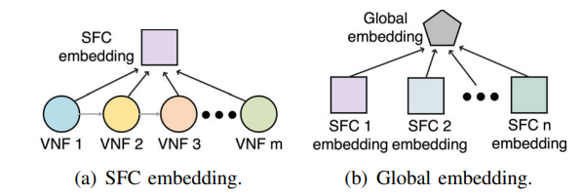
Two levels of embedding networks

Slide 36
Training
Advantage Actor-Critic (A3C) predicts value function V as well as the optimal policy function π.
The value function is used to evaluate the action and the policy function is used to generate an optimal action.
The agent use A3C algorithm to update the parameters θ of policy π(a_{i}|s_{i}; θ’ ) and the parameters θ_{v} of value function V (s_{i}; θ’_{v}).

Slide 37
R is time-discounted reward and (R − V (s_{i}; θ’_{v})) estimates how much better the reward is in a step compared to the long term reward.
∇_{θ’} log π(a_{i}|s_{i}; θ ) indicates the direction to increase the probability of making action ai at state s_{i}. It also teaches the agent to choose those actions that can obtain above-average reward.

Slide 38

The below equation aims to reduce the difference between estimated reward value and actual reward. A3C makes use of multiple agents (or workers) with each agent having its own local parameters and a copy of the environment. These agents interact with their local environments asynchronously, and upload updates to the global network periodically.

Slide 39
Conclusion
The main motive is to have high reliability and low latency. This paper consists of two approach’s, namely redundancy determining and SFC scheduling.
For former step, an efficient algorithm is developed to determine the minimum number of redundancies to guarantee the reliability without much processing time.
In the latter step, a scheduling algorithm is proposed based on reinforcement learning, as well as an embedding technique for encoding the features into low-dimensional vectors.
By simulation results it is shown to increase the success rate of dynamically arriving SFCs, especially at a high redeployment time.

